Slide 1

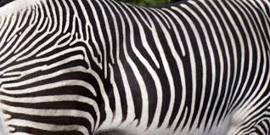
Tiger stripes sign
Dr rakesh jain
Senior resident, dept of cardiology
Govt. medical college, calicut

Slide 2
Tiger stripes / zebra stripes appearance
High amplitude band like signal (usually mottled in appearance), noted on Doppler spectral recordings (on both pulsed and continuous waveforms)
May occur with any intracardiac oscillating structures
Associated with valvular regurgitation, most often noted with flail porcine mitral prosthetic valves (tissue valve) and may be indicative of an acute flail prosthetic leaflet
Edmund Kenneth Kerut. ECHOCARDIOGRAPHY, Volume 24, May 2007

Slide 3
An unusual band like signal noted on the pulse wave
Doppler recording of a patient with moderate native
valve aortic regurgitation
Tiger stripes noted in a pulsed wave Doppler
recording of a flail porcine mitral leaflet

Slide 4
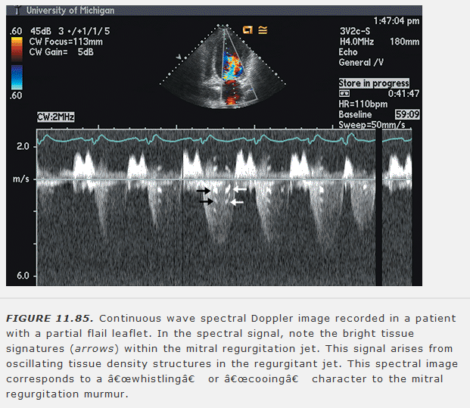

Slide 5
mechanism
Not clear
Caused by fluttering of the disrupted cusp leading to the shedding of families of vortices in both a retrograde and an orthograde direction. Number of striations in the signal is likely to be related to the frequency of oscillation of the cusp and the presence or absence of mottling to the pattern of shedding of the vortices.¹
Intracardiac oscillating structure > structures vibrate with a single high frequency (not chaotic) with several harmonic overtones > tiger stripes > first band represent lowest frequency on the Doppler recording and representing its fundamental frequency.²
1. John B Chambers et al J Am Coil Cardiol 1987;10:462-6
2. Edmund Kenneth Kerut. ECHOCARDIOGRAPHY, Volume 24, May 2007

Slide 6
Specificity of the sign ?
Although flutter of the cusps of prosthetic mitral valves is most commonly reported in the presence of cusp tears and tiger stripes sign
May also be seen in other situations
Harrison et al. ¹ and Jacovella et al. reported a small number of patients with diastolic flutter in the presence of paraprosthetic leaks and normal cusps.
Hatle and Angelsen² presented a brief description of findings similar to tiger stripes sign in native mitral and aortic valves but without a pathologic correlation.
It is possible that Doppler signals resembling tiger stripes may be found in any situation in which flutter of one or a part of one cusp occurs in the presence of normal motion of the other parts of the valve
1.Jacovella G, Narducci C, Pino PG, Salati A. Echocardiographic features of porcine valve dysfunction. Am J Cardiol 1980;46:526.
2. Halle L, Angelsen B. Doppler Ultrasound in Cardiology. Philadelphia: Lea & Febiger, 1985:278.

Slide 7
THANKS

